Slide 1

HTML and CSS
Course Overview
SoftUni Team
Technical Trainers
Software University
http://softuni.bg

Slide 2
Table of Content
Introduction
Training and Team
Course Objectives
Course Organization

Slide 3
Have a Question?
sli.do
#html-css

Slide 4












SoftUni Diamond Partners

Slide 5




SoftUni Organizational Partners

Slide 6

HTML and CSS
Course Objectives & Program

Slide 7

HTML and CSS - Course Topics
Introduction to HTML and CSS
HTML Structure
3. CSS & Typography
4. CSS Box Model
5. Position & Float
6. Flexbox

Slide 8
HTML and CSS - Course Topics
8. Media Queries
9. Design to Code – Demo Project
10. Exam Preparation

Slide 9

Trainers and Team

Slide 10
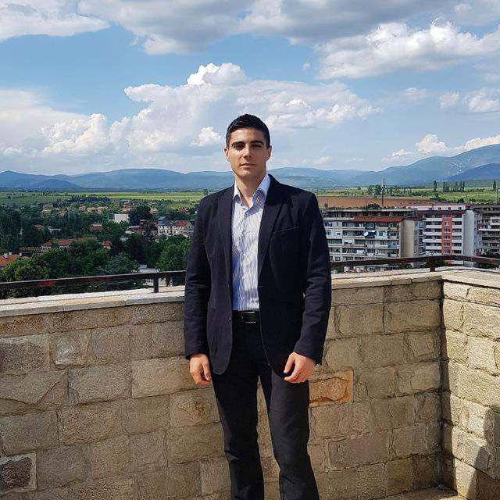
William Abboud
Full Stack & Senior Front-End Developer @ SoftUni
Studied Computer Science in Newcastle University
Passionate about
HTML/CSS/JS/React.js
UX/UI Design

Slide 11

Course Objectives
Course Details and Schedule

Slide 12
Why HTML & CSS?
HTML & CSS - standard for Web User Interface (UI)
Web-based applications are very popular
Runs on any device with a web browser
HTML5 is currently the #1 job trend based on the fastest growing keywords found in online job postings
HTML5 takes bigger chunk of the mobile application market
Every IT professional should know HTML & CSS

Slide 13

Practical Exam
Structure: 3 problems for 4 hours
Slice a screenshot to HTML + CSS
Make a responsive page
Create a simple landing page from screenshot (header + menu + sidebar + form elements + footer)

Slide 14
Theoretical Exam
20 questions for 20 minutes
Multiple-choice with 1 correct answer
English
Automated quiz system
Available online the day of the practical exam
You can submit your answers just one time

Slide 15

Course Organization
Resources

Slide 16



Scoring System for the Course
Theoretical Exam 10%
PracticalExam 90%
Homework 5 %
Evaluation

Slide 17
Homework Assignments
Doing your homework is very important!
HTML and CSS can only be learned through a lot of practice!
You should write code every day!
Each lesson is followed by a few exercises
Try to solve them in class
The rest are your homework
Homework assignments are due in 7 days after each lesson
Submission are accepted through: judge.softuni.bg

Slide 18
Website, Forum and FB Group
Official website:
Official discussion forum:
Official Facebook group:
https://softuni.bg/trainings/2784/html-and-css-february-2020
https://softuni.bg/forum/categories/55/HTML-CSS
https://www.facebook.com/groups/HTMLandCSSFebruary2020/

Slide 19
Code Editors
You may try many HTML authoring tools
Recommended:
Visual Studio Code
Other notable editors:
WebStorm
Sublime Text / Atom / Brackets

Slide 20
Learn to Search in Internet & Find Solutions
The course assignments require to search in Internet
This is an important part of the learning process
Some exercises intentionally have no hints
Learn to find solutions!
Software development includes everyday searching and learning
No excuses, just learn to study!
Developers learn new technologies, tools, languages every day!

Slide 21
https://softuni.bg/trainings/2501/html-and-css-september-2019

Slide 22




Trainings @ Software University (SoftUni)
Software University - High-Quality Education and Employment Opportunities
softuni.bg
Software University Foundation
http://softuni.foundation/
Software University @ Facebook
facebook.com/SoftwareUniversity
Software University Forums
forum.softuni.bg

Slide 23

License
This course (slides, examples, demos, videos, homework, etc.) is licensed under the "Creative Commons Attribution-NonCommercial-ShareAlike 4.0 International" license

